Slide 1
AI-Systems Hardware For Machine Learning (294-162)
Amir Gholami & Joseph E. Gonzalez

Slide 2
Acknowledgments
Many slides from Prof. Kurt Keutzer, Suresh Krishna, Prof. Patterson, Michael Pellauer (Nvidia), Prof. Sophia Shao, Naveen Kumar (Google), Pallas Group

Slide 3
Agenda for Today
1:10-2:00: Preliminary Lecture on Hardware for ML
2:00-2:45: PC Meeting Discussions
2:45-3:00: Break
3:00-4:00: Guest Lecture by Dr. Reynold Xin (Databricks)

Slide 4
Objectives For Today
Key Trends in Hardware and motivation for DSAs
Reduced Precision Training
Different DataFlow Patterns in Hardware
How to evaluate a HW with Roofline Model
Important context for papers and what to expect

Slide 5
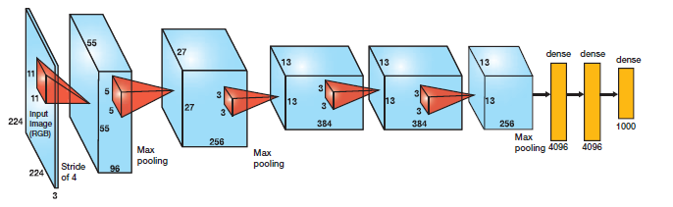


Key Drivers for Neural Network Success
Faster
Computation
More Complex Nets
More
Data
DARPA Neural Network Study Final Report (606 pages):
“After participating in this Study, my personal view is that neural networks will provide the next major advance in computing technology.”
Dr. Jasper Lupo
DARPA, Washington, DC
June, 1988

Slide 6
AlexNet vs Lenet5: 1000x More Compute
1500x
Amir Gholami, Zhewei Yao, Sehoon Kim, Michael W. Mahoney, Kurt Keutzer, AI and Memory Wall, Riselab Medium Blogpost, 2021.

Slide 7
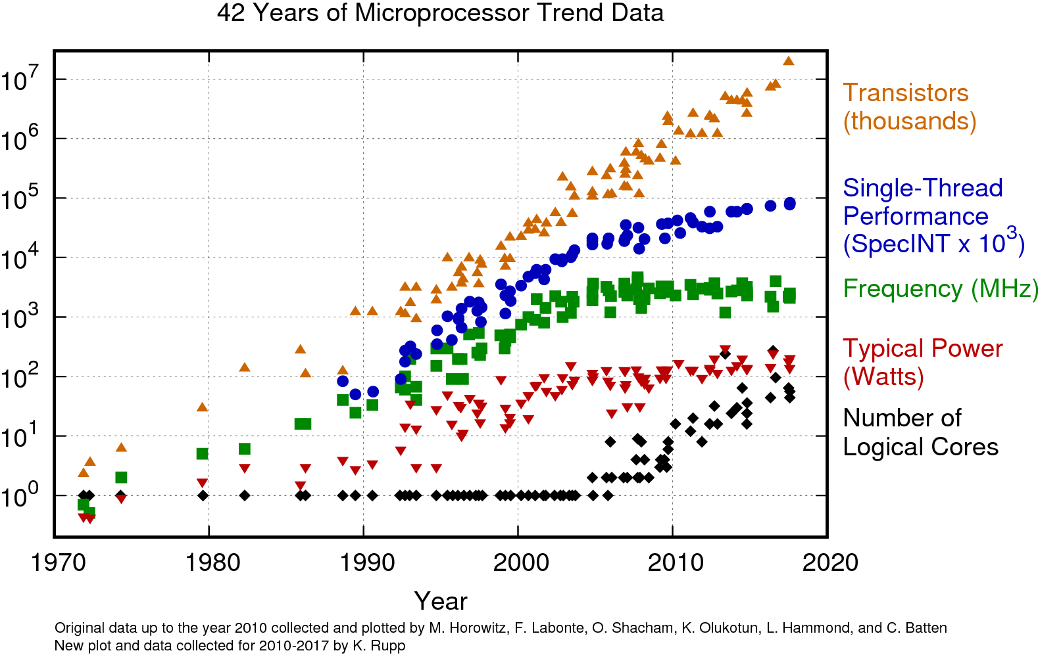
General Purpose Hardware Trend
Key Observations
# Transistors still increasing
Single Core Performance Plateauing
End of Dennard Scaling
Distributed Computing
42 Years of Microprocessor Trend Data, Karl Rupp

Slide 8
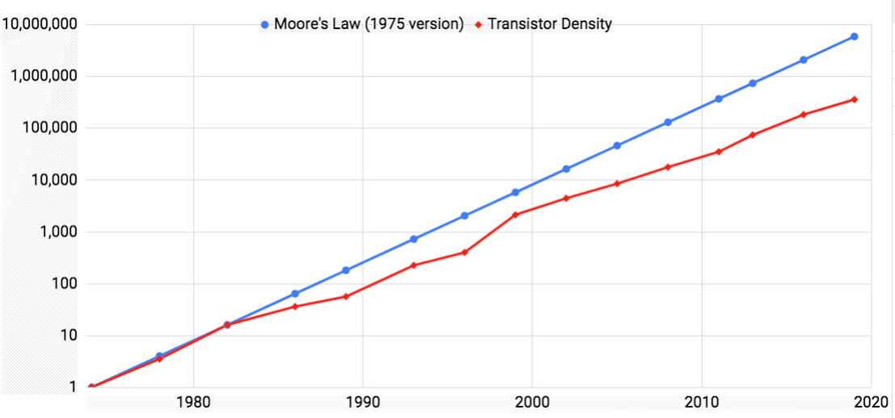
Common Fallacy: Moore’s Law is not Dead
15X
Moore, Gordon E. "No exponential is forever: but ‘Forever’ can be delayed!" Solid-State Circuits Conference, 2003.
Slide from Prof. Patterson

Slide 9
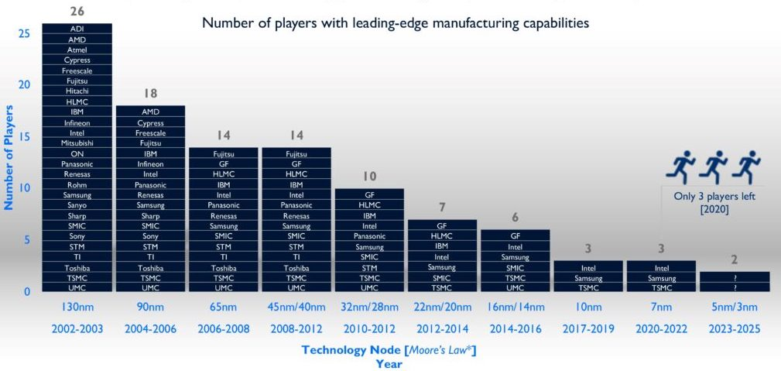
It is becoming increasingly difficult to push the boundary
Building a 3nm fab costs around $20B. This is still economical given the $600B ARR for the semi-conductor industry, but it is questionable how much farther we can push the limit.
Source: high end performance packaging 3d/2.5d integration report, Yole, Development, 2020.

Slide 10
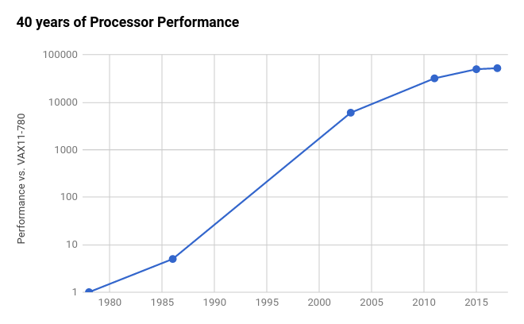
But It has Slowed Down
End of the Line?
2X / 20 yrs
(3%/yr)
Am-
dahl’s
Law
⇒
2X / 6 yrs (12%/yr)
End of Dennard
Scaling
⇒
Multicore
2X / 3.5 yrs
(23%/yr)
RISC
2X / 1.5 yrs
(52%/yr)
CISC
2X / 3.5 yrs
(22%/yr)
Based on SPECintCPU. Source: John Hennessy and David Patterson, Computer Architecture: A Quantitative Approach, 6/e. 2018
Notes:
RISC - threw computers away since too slow
Have to rethink what we’re doing

Slide 11

Domain Specific Accelerators
John Hennessy and David Patterson, “A New Golden Age for Computer Architecture,” Communications of the ACM, February 2019

Slide 12

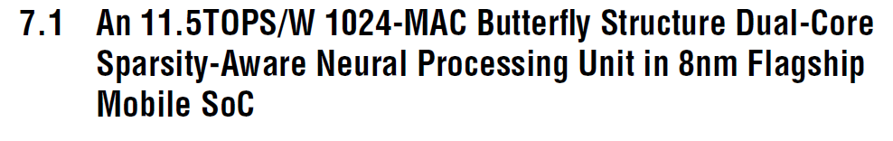
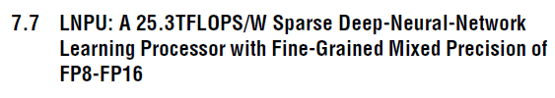
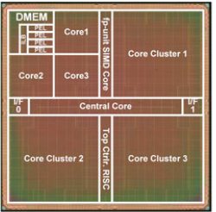
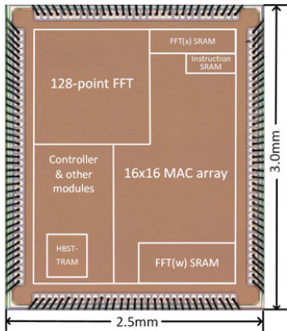
Domain Specific Accelerators
SnapDragon 835 (→ 845 → 855)
~3.23 – 4 MOPS/mW (835)
11– 16.6 GFLOPS SGEMM (835)
2.5K – 30K X increase in MOPs/mW
11,500 MOPS/mW
25,300 MOPS/mW
140,300 MOPS/mW

Slide 13
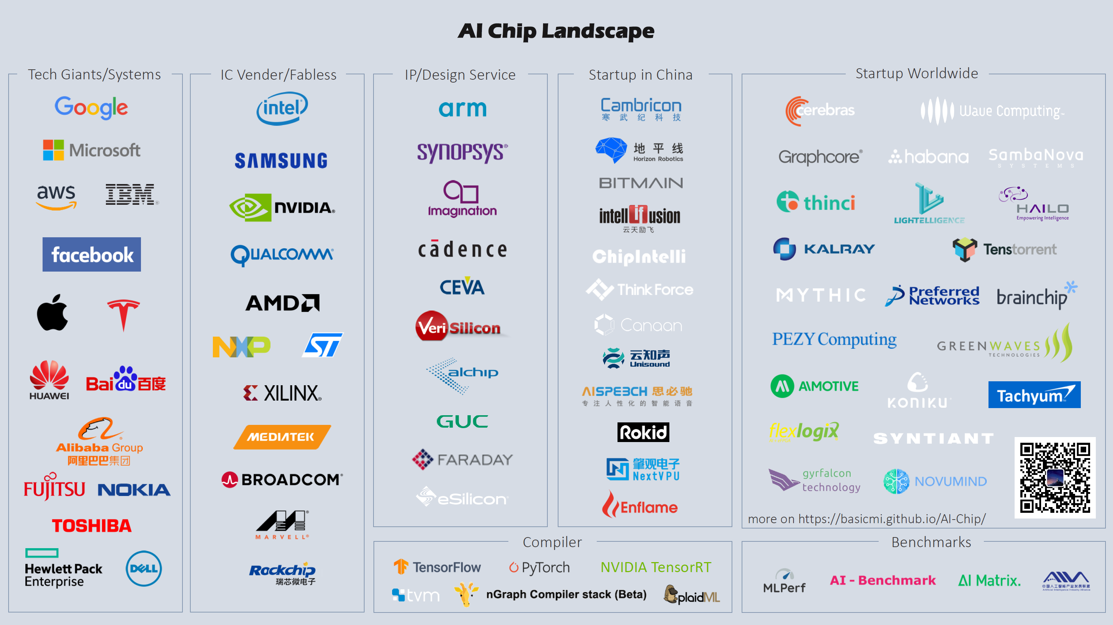
basicmi.github.io/AI-chip

Slide 14
Two Important Innovations in AI Hardware That We Will Cover Today
Low Precision Arithmetic Units
Custom DataFlow Design

Slide 15
Low Precision Training

Slide 16
Low Precision Training
For a lot of the operations in ML we use randomized algorithms. So why not use low precision instead of FP32 or FP64?
1.21042
× 0.61127
0.73989343
about 1.2
× about 0.6
about 0.7
=>
First, let’s see how much performance gain we can get
Second, there are subtleties associated with limited precision that need to be resolved

Slide 17
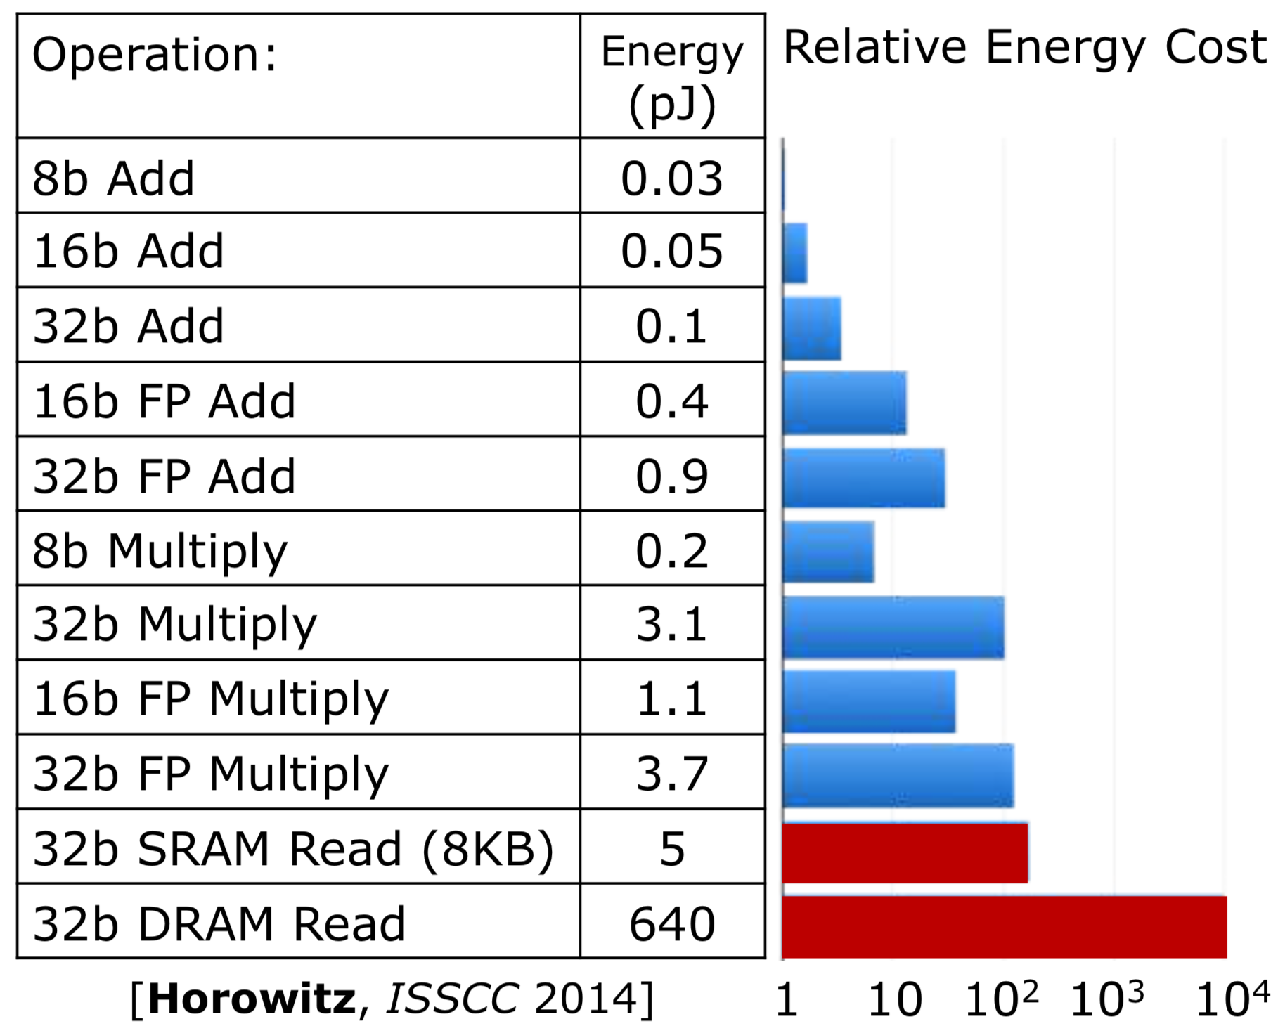
How much is on the table with low precision?
At least 2x reduction in energy with FP16 compute

Slide 18
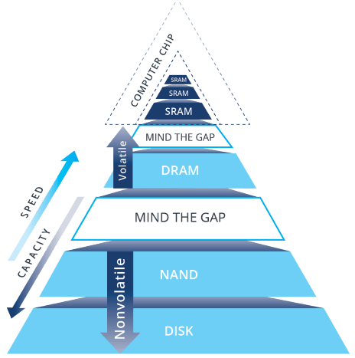
How much is on the table with low precision?
At least 2x reduction in energy with FP16 compute
Significant gains in power if the parameters could be stored in SRAM vs DRAM
Memory hierarchy from Andrew Walker, EE Times.

Slide 19
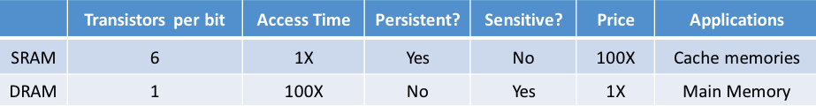
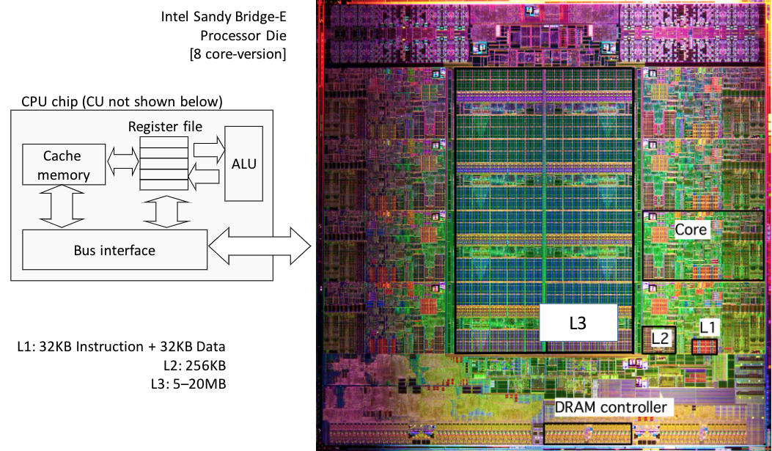
Why can’t we just increase SRAM?
SRAM is 100x more expensive than DRAM and importantly occupies more area of the chip!
Using FP16 instead of FP32/64 reduces access volume without having to incur this cost
Intel Sandy Bridge-E Processor Die (Credit Rui Pan)

Slide 20
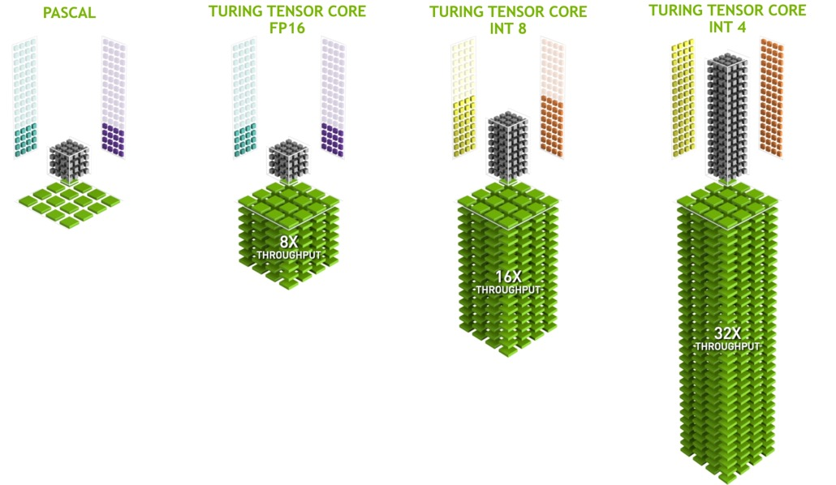
Faster Compute with FP16
The main reason for higher throughput is that FP16 ALUs take less area on the chip so we can pack more ALUs per unit area

Slide 21
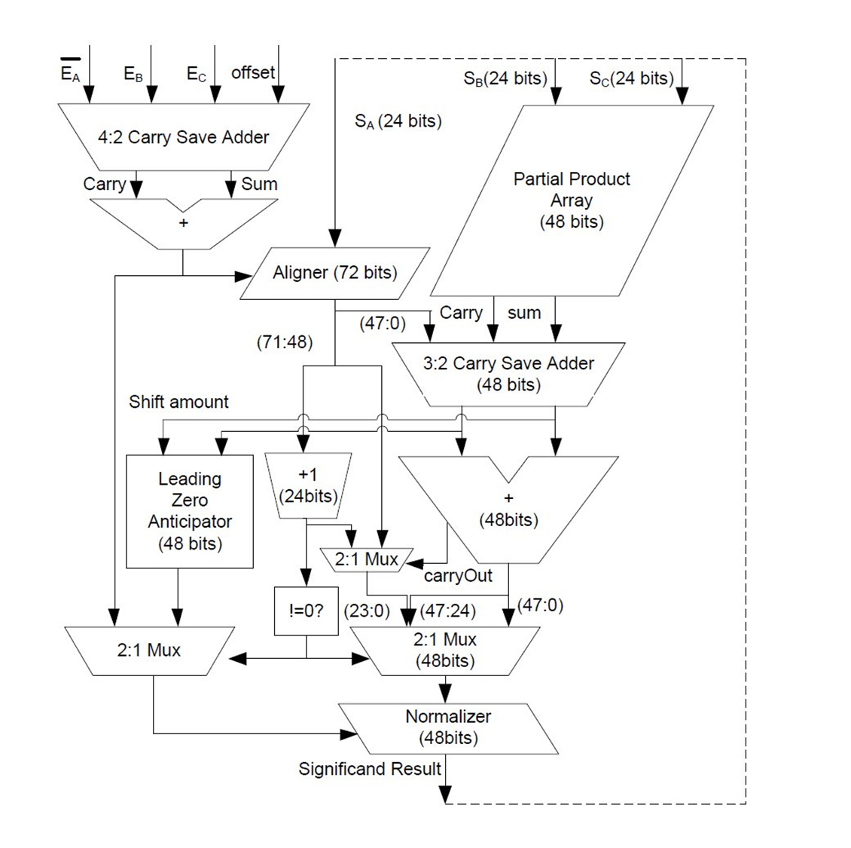
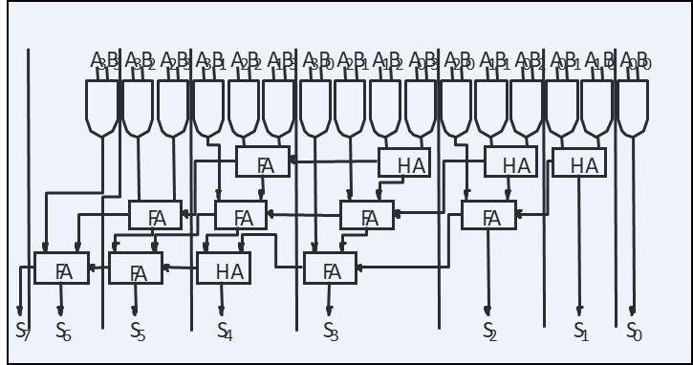
Lower Precision Arithmetic Requires Less Transistors -> Less Area
4b
4b
X
8b
+
16b
int4 MAC
4 bit multiply , 16 bit accumulator
~700 gates
24 X less gates
32 bit FP fused MAC
17K gate equivalents
Notes:
S. Galal, “ENERGY EFFICIENT FLOATING-POINT UNIT DESIGN”,
http://www-vlsi.stanford.edu/people/alum/pdf/1211_SamehGalal_FP_Design.pdf
Randy Katz, “Arithmetic Circuits”, Part II, CS150 Lecture#24, Fall 2005
Sumant Dalmiya, “A Comparative Study of Adders “, UT MSE Report, 2015, https://repositories.lib.utexas.edu/bitstream/handle/2152/35326/DALMIYA-MASTERSREPORT-2015.pdf?sequence=1&isAllowed=y

Slide 22
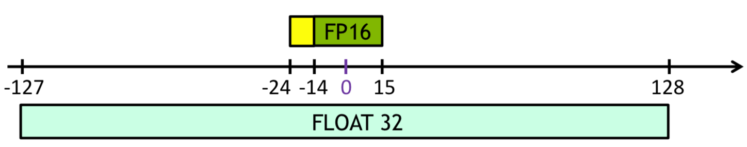
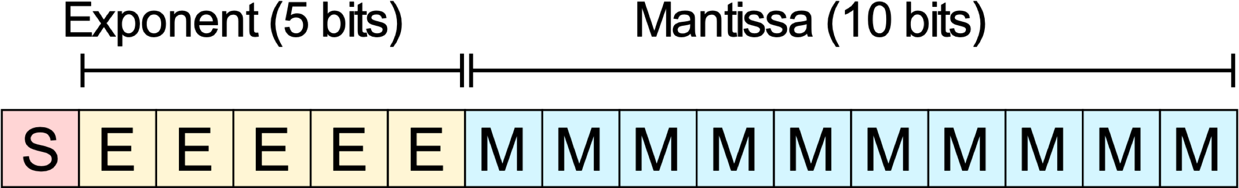
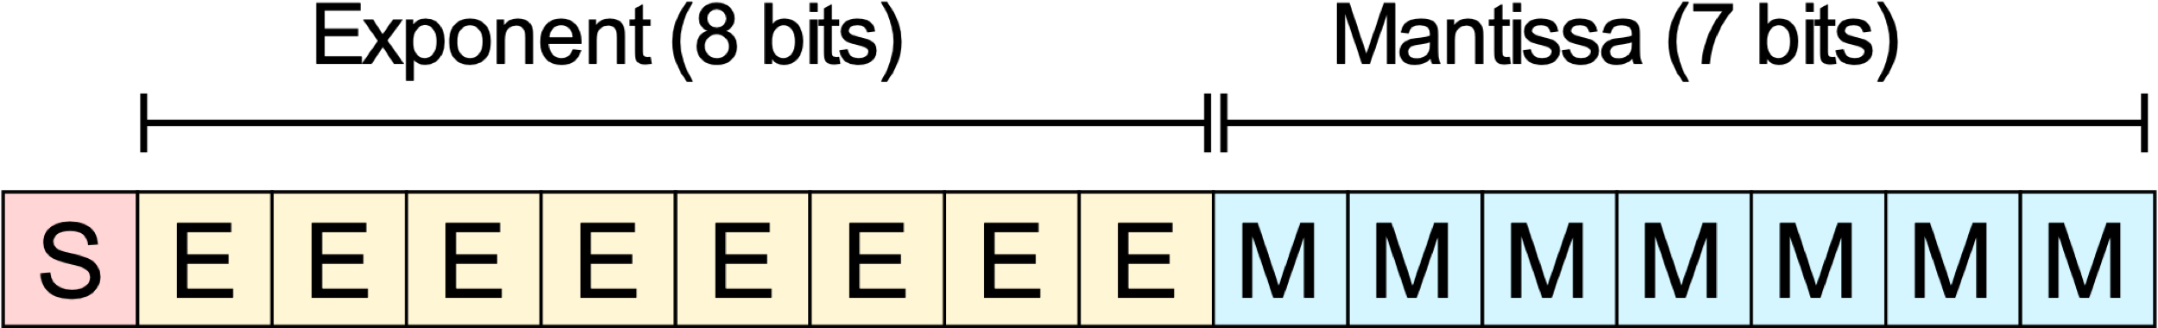
16 Bit Representation
Float32: (range ~1e⁻³⁸ to ~3e³⁸)
Float16: (range ~5.96e⁻⁸ to 65,504)
BFloat16: (range ~1e⁻³⁸ to ~3e³⁸)
* Google largely avoided low precision training problems with BFLOAT16

Slide 23
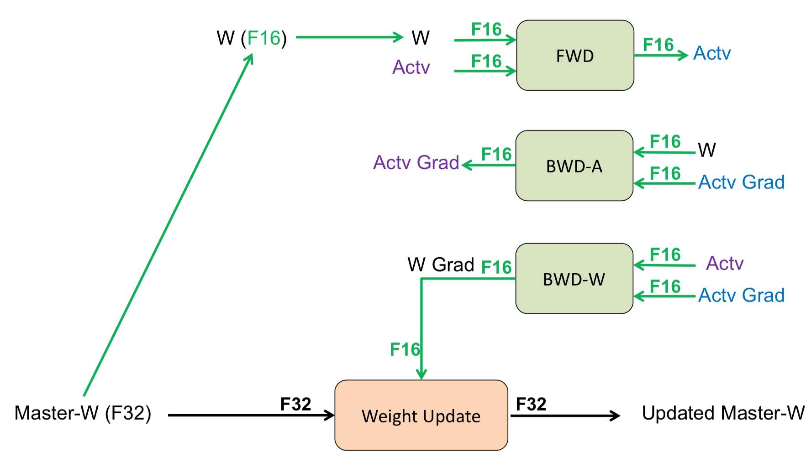
FP16/32 Training Workflow

Slide 24
ML Challenges with FP16 Training
Naïve FP16 training leads to divergence/poor accuracy
FP16 has very limited dynamic range:
Max =65504 , Min Normal Number = 2⁻¹⁴
This creates several challenges in training NN:
Loss of precision during weight update
Exacerbates ‘‘vanishing and exploding gradients’’
Overflow/underflow for layer activations during forward/backward pass
Loss curve for training AlexNet on ImageNet
P. Micikevicius, S. Narang, J. Alben, G. Diamos, E. Elsen, D. Garcia, B. Ginsburg, M. Houston, O. Kuchaiev, G. Venkatesh, H. Wu. Mixed precision training. ICLR’18. B. Ginsburg, S. Nikolaev, A. Kiswani, H. Wu, A. Gholami, S. Kierat, M. Houston, A. Fit-Flores. Tensor processing using low precision format. US Patent 15/624577.

Slide 25
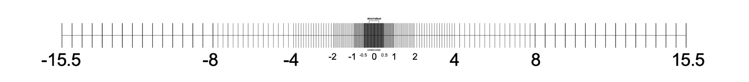
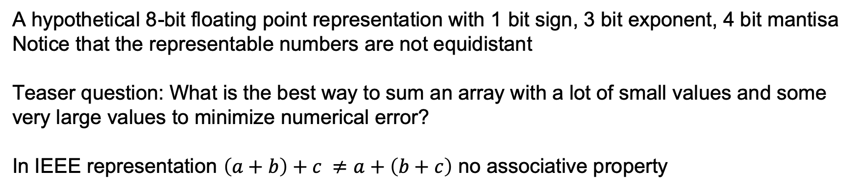
Limitations of Floating Points
There are only a finite number of different floats
Floats are discrete but not equidistant
A hypothetical 8-bit floating point representation with 1 bit sign, 3 bit exponent, 4 bit mantisa
Notice that the representable numbers are not equidistant
Teaser question: What is the best way to sum an array with a lot of small values and some very large values to minimize numerical error?
In IEEE representation $\left(a+b\right)+c ≠a+\left(b+c\right)$ no associative property
Figure Reference: volkerschatz.com

Slide 26
Unit in the Last Place (ULP)
Floating points can only represent specific real valued numbers
Can lead to stalling at one point if the gradients are small
a
a + 1ULP

Slide 27
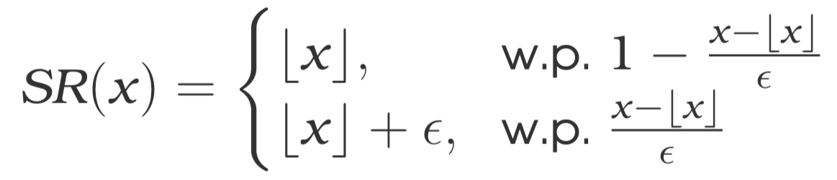
Stochastic Rounding
One popular solution proposed to avoid this stalling is stochastic rounding
a
a + 1ULP
Gupta S, Agrawal A, Gopalakrishnan K, Narayanan P. Deep learning with limited numerical precision. InInternational Conference on Machine Learning 2015 Jun 1 (pp. 1737-1746).
Ho ̈hfeld, Markus and Fahlman, Scott E. Probabilistic rounding in neural network learning with limited precision. Neurocomputing, 4(6):291–299, 1992.

Slide 28
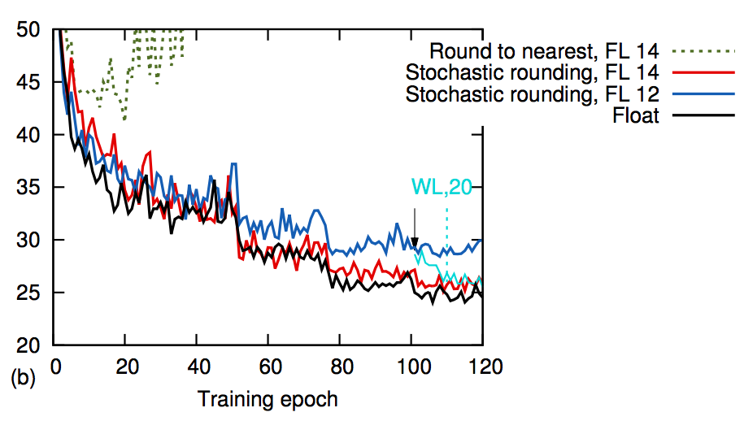
Stochastic Rounding
About 5 percent accuracy loss for a 3 layer CNN on Cifar-10
Gupta S, Agrawal A, Gopalakrishnan K, Narayanan P. Deep learning with limited numerical precision. In International Conference on Machine Learning 2015 Jun 1 (pp. 1737-1746).
Ho ̈hfeld, Markus and Fahlman, Scott E. Probabilistic rounding in neural network learning with limited precision. Neurocomputing, 4(6):291–299, 1992.

Slide 29
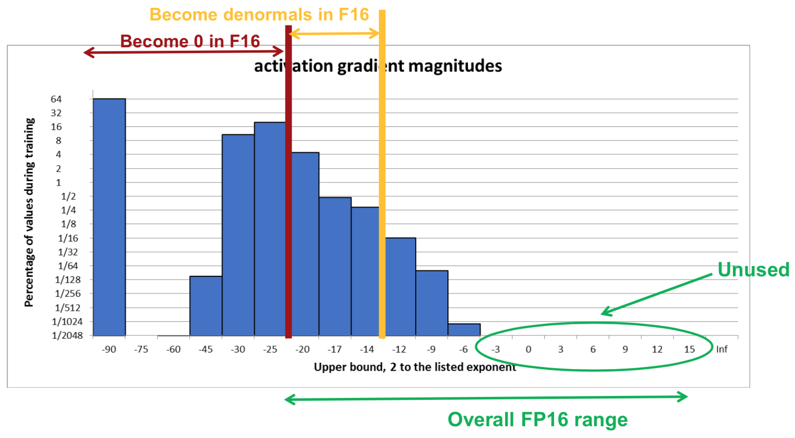
Vanishing Gradient Problem
Main problem is in representing gradients
Solution to be discussed during next week’s PC meeting for [Micikevicius, 2018] paper!

Slide 30
Further Reading (INT8 Training?)
Several recent papers have proposed INT8 training. The ideas are interesting but:
Many layers need to be kept at higher precision (FP16 or FP32)
Master copy of weights needed at higher precision
Lots of Hyper-parameter tuning is needed
Interesting papers to read:
Training DNNs with 8-bit FPs [NeurIPS’18]
HybridFP8 Training [NeurIPS19]
Shifted and Squeezed 8-bit Floating Point [ICLR’20]

Slide 31
Custom DataFlow

Slide 32
Motivation: Use A Custom DataFlow to minimize DRAM Accesses
DRAM access are 100x costlier than SRAM.
The number of times that we access DRAM depends on the order of the computations in our code!
The goal is to find an order/dataflow to minimize this cost

Slide 33
Custom DataFlow Motivation
DRAM
(Weights, Inputs, Outputs)
Minimize data fetching from DRAM
On-Chip Buffer
Compute Core
Intel Sandy Bridge-E Processor Die (Credit Rui Pan)

Slide 34
Taxonomy of Dataflow in NN Accelerators
We can classify NN accelerators based on spatial/systolic architecture according to the type of data each PE locally reuses.
Weight Stationary (WS)
A PE reuses a kernel weight across different input activations.
Examples: TPU[2], CNP[3]
Output Stationary (OS)
A PE accumulates partial products.
Examples: ShiDianNao (SOC-MOP)[4], Envision (MOC-MOP)[5], DNA[6]
[1] Y.-H. Chen, et. al., “Eyeriss: A Spatial Architecture for Energy-Efficient Dataflow for Convolutional Neural Networks,” 2016.
[2] N. Jouppi, et al., “In-Datacenter Performance Analysis of a Tensor Processing Unit,” 2017.
[3] C. Farabet, et al., “CNP: An FPGA-based processor for Convolutional Networks,” 2009.
[4] Z. Du, et al., “ShiDianNao: Shifting vision processing closer to the sensor,” 2015.
[5] B. Moons, et al., “Envision: A 0.26-to-10TOPS/W subword-parallel dynamic-voltage-accuracy-frequency-scalable Convolutional Neural Network processor in 28nm FDSOI,” 2017.
[6] F. Tu, et al., “Deep Convolutional Neural Network Architecture With Reconfigurable Computation Patterns,” 2017.C

Slide 35
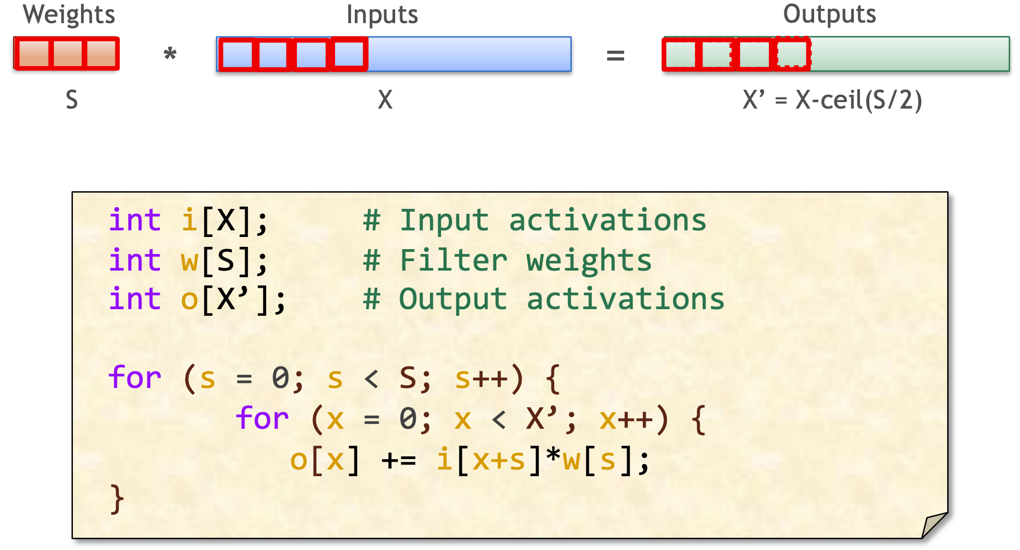
Weight Stationary DataFlow (TPU)
How often are outputs/inputs accessed?
How about the weights?
Every Cycle
Every X’ Cycles

Slide 36
What do we mean by Stationary?
The datatype (and dimension) that changes most slowly
Imprecise analogy: think of data transfers as a wave with “amplitude” and “period”
The stationary datatype has the longest period (locally held tile changes most slowly)
Later we will see how intermediate staging buffers reduce both bandwidth and energy
Often corresponds to datatype that is “done with” earliest without further reloads
Michael Pellauer, MICRO, 2020

Slide 37
Impact of Local Buffer
DRAM
(Weights, Inputs, Outputs)
On-Chip Buffer
Buffer size be to minimize refetching data from DRAM?
Dataflow | Outputs | Inputs | Weights
Weight Stationary (WS) | X’ | X | 1
Compute Core
What is the energy cost of accessing the buffers?
Where f is the energy of accessing a buffer of size x. See PPT notes for derivation.
Notes:
Deriving the energy cost is very simple:
For all of the loop over x (inner loop), we only need to read w[s] once. The cost of this is f(1) as the buffer size for weights is 1.
Accessing i[x+s] at every iteration requires reading the input buffer which has a size of X’. Therefore this energy cost per cycle is f(X’)
Similarly, accessing o[x] has a cost of f(X’) to read the current value stored in the buffer, and an additional f(X’) to write back the result after accumulation
The above three result in an energy cost of f(1) + f(X’) + 2f(X’). The loop has a total of SX’ iterations, hence the result in the slide.
SX’ [f(X’) + f(X') + f(X') + f(1)]

Slide 38
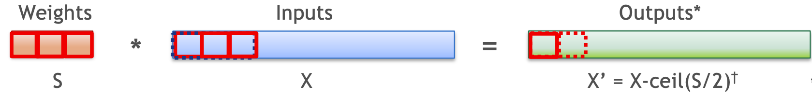
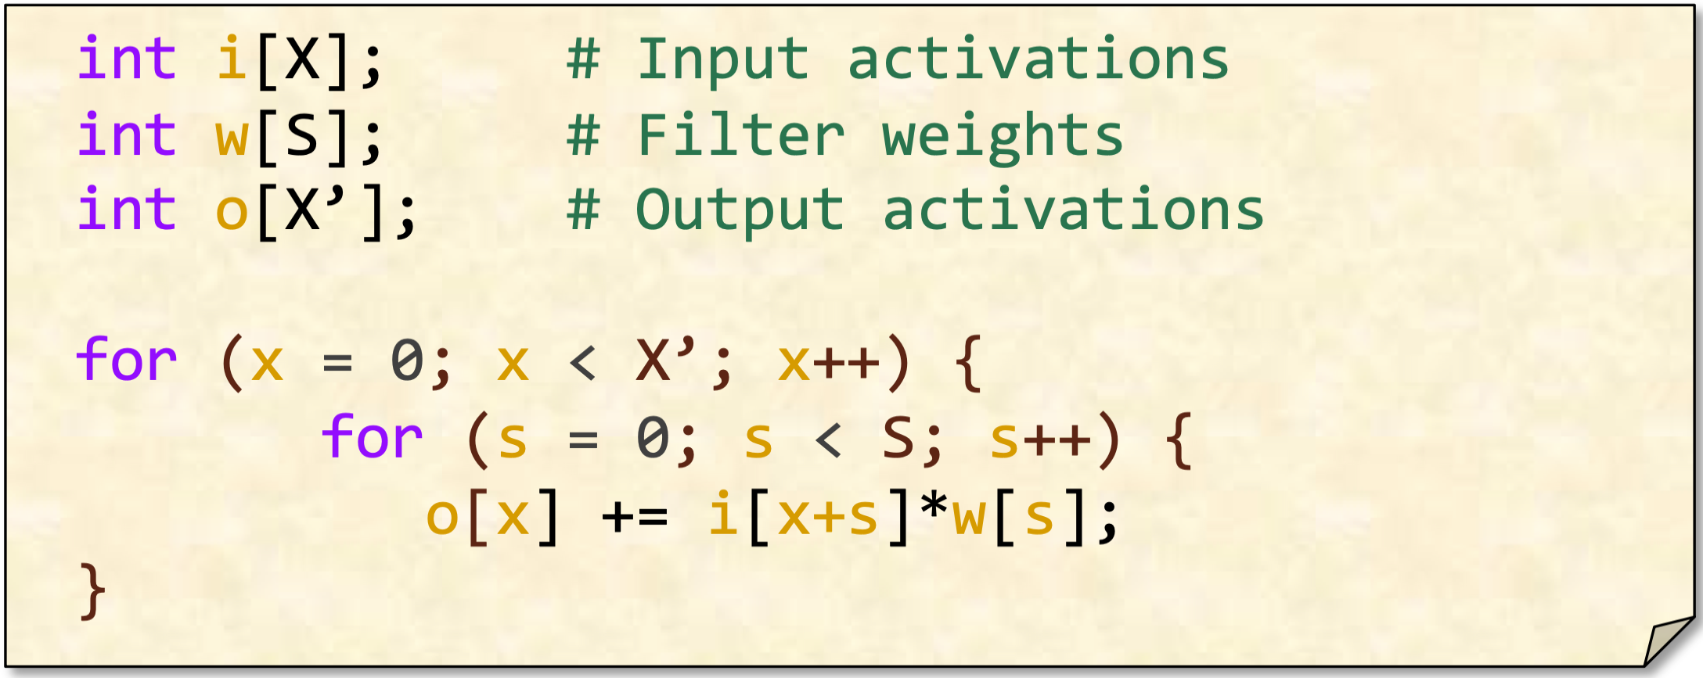
Output Stationary DataFlow
How often are outputs accessed?
How about weights/inputs?
Every S Cycles
Every Cycle

Slide 39
Impact of Local Buffer: OS
DRAM
(Weights, Inputs, Outputs)
On-Chip Buffer
Buffer size be to minimize refetching data from DRAM?
Dataflow | Outputs | Inputs | Weights
Output Stationary (OS) | 1 | S | S
Compute Core
What is the energy cost of accessing the buffers?
Where f is the energy of accessing a buffer of size x. See PPT notes for derivation.
Notes:
Deriving the energy cost is very simple:
For all of the loop over s (inner loop), we only need to read o[s] once. The cost of this is f(1) as the buffer size for outputs is 1. We also need to write to this buffer and thus we will incur another f(1) cost.
Accessing i[x+s] at every iteration requires reading the input buffer which has a size of S. Therefore this energy cost per cycle is f(S)
Similarly, accessing w[s] has a cost of f(S).
SX’ [f(1) + f(1) + f(S) + f(S)]

Slide 40
Weight Stationary vs Output Stationary
Buffer size be to minimize refetching data from DRAM
Dataflow | Outputs | Inputs | Weights
Weight Stationary (WS) | X’ | X | 1
Output Stationary (OS) | 1 | S | S
Very different energy cost of accessing the local buffers by just a change in the loop order
WS:
OS:

Slide 41
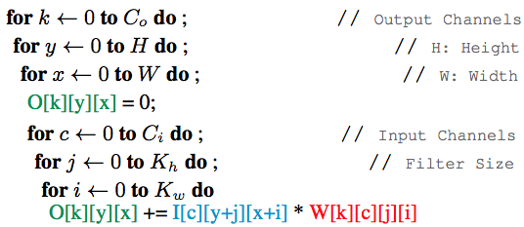
Convolution: Restructured as Matrix Multiplication
Input
Weight
Output
0,0
0,1
0,2
0,3
w2,0
w2,1
w2,2
2,0,0
2,0,1
0,0
0,1
0,2
0,3
In practice we deal with more complex loop structures.
Stay tuned for the compilers lecture on how ML could be used to optimize the dataflow pattern for these cases.
0,0
0,1
0,2
0,3
w1,0
w1,1
w1,2
1,0,0
1,0,1
1,0
1,1
1,2
1,3
1,0
1,1
1,2
1,3
1,0
1,1
1,2
1,3
w0,0
w0,1
w0,2
0,0,0
0,0,1
2,0
2,1
2,2
2,3
2,0
2,1
2,2
2,3
2,0
2,1
2,2
2,3
w0,3
w0.4
w0,5
0,1,0
0,1,1
3,0
3,1
3,2
3,3
3,0
3,1
3,2
3,3
3,0
3,1
3,2
3,3
w0,6
w0,7
w0,8

Slide 42
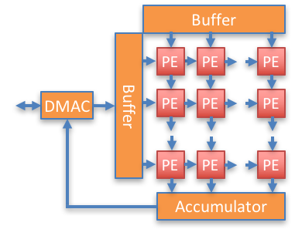
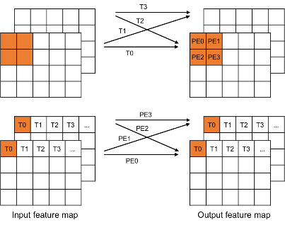
Squeezelerator: Hybrid WS/OS (Berkeley, Samsung)
Squeezelerator: Supports hybrid WS and OS data flow: up to 6x reduction in energy over OS, WS
Determines execution flow statically based on trained weights (one time setup cost per network)
Output Stationary
Weight Stationary
Kwon, Kiseok, Alon Amid, Amir Gholami, Bichen Wu, Krste Asanovic, and Kurt Keutzer. "Co-design of deep neural nets and neural net accelerators for embedded vision applications." In 2018 55th ACM/ESDA/IEEE Design Automation Conference (DAC), pp. 1-6. IEEE, 2018.
Notes:
Goal of WS: Reduce overhead of Weight read and write
Goal of OS: Reduce partial sum communication

Slide 43
Squeezelerator: Hybrid OS/WS
Up to 6x Speedup relative to other architectures
Kwon, Kiseok, Alon Amid, Amir Gholami, Bichen Wu, Krste Asanovic, and Kurt Keutzer. "Co-design of deep neural nets and neural net accelerators for embedded vision applications." In 2018 55th ACM/ESDA/IEEE Design Automation Conference (DAC), pp. 1-6. IEEE, 2018.
Gholami A, Kwon K, Wu B, Tai Z, Yue X, Jin P, Zhao S, Keutzer K. Squeezenext: Hardware-aware neural network design. In Proceedings of the IEEE Conference on Computer Vision and Pattern Recognition Workshops 2018 (pp. 1638-1647).
Notes:
Squeezelerator achieves up to 2x and 6x speedup compared to reference OS and WS architectures, respectively.
Like other NN accelerators, Squeezelerator can achieve big (100x) over traditional architectures
Squeezelerator achieves up to 2x and 6x speedup compared to reference OS and WS accelerator architectures.
Squeezelator has the biggest impact on MobileNet, since MobileNet consist of two different layer types, which are favorable to OS and WS

Slide 44
How to Evaluate HW Performance
FLOPs is not the same as wall clock time

Slide 45
Williams Roofline Model
For decades programmers and architects did back-of-the-envelope calculations on compute vs communication at various levels of the memory hierarchy
Processor to register file
On-chip L1, L2 (L3?) caches
Off-chip DRAM
Interprocessor communication
UC Berkeley grad student Sam Williams gave a simple model, known as the Roofline Model, for reasoning about these issues
Williams, Samuel, Andrew Waterman, and David Patterson. Roofline: An insightful visual performance model for floating-point programs and multicore architectures. No. LBNL-2141E. Lawrence Berkeley National Lab.(LBNL), Berkeley, CA (United States), 2009.

Slide 46
Roofline Model: y-axis
The y-axis describes the attained performance
It’s easy to add the “peak performance” as an upper bound
128
64
Peak flops
32
16
attainable Gflop/s
8
4
2
1

Slide 47

Roofline Model: x-axis
The x-axis tells indicates for this particular application/kernel, for each floating-point operation (flop), how many bytes (B) must be fetched
For example if we have to fetch half precision floating-point numbers for each floating point operation, then:
1 FP16: 2 bytes (16n ts)
2 double precision float: 16 bytes
1 flop requires 16 DRAM bytes
128
Different applications/kernels,
not processors, move us along the X-axis
64
32
16
attainable Gflop/s
8
4
Kernel’s Arithmetic Intensity
2
1
¹/₈
¹/₄
¹/₂
1
2
4
8
16
Flops/byte

Slide 48
Roofline Model: x-axis
The x-axis tells indicates for this particular application/kernel, for each floating-point operation (flop), how many bytes (B) must be fetched
For example if we have to fetch half precision floating-point numbers for each floating point operation, then:
1 FP16: 2 Bytes (16 bits)
2 FP16: 4 Bytes (32 bits)
1 FLOP requires 4 DRAM Bytes
128
Different applications/kernels,
not processors, move us along the X-axis
64
32
16
attainable Gflop/s
8
4
Kernel’s Arithmetic Intensity
2
1
¹/₈
¹/₄
¹/₂
1
2
4
8
16
Flops/Byte

Slide 49
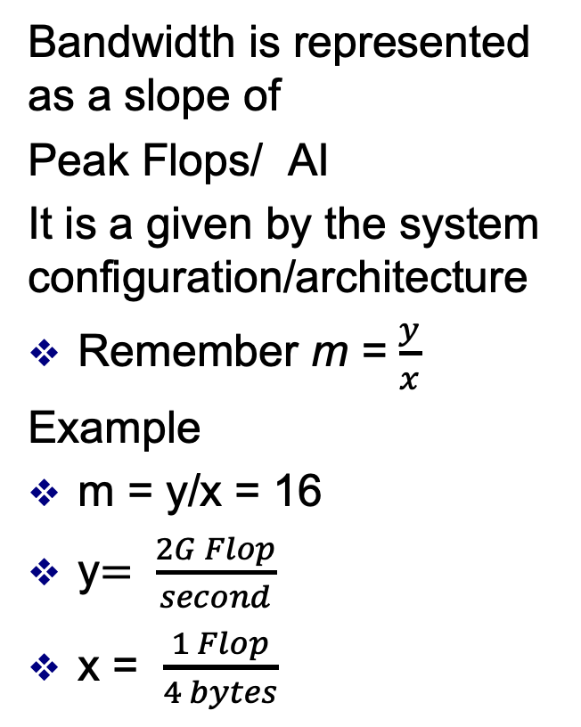
Bandwidth as Slope
128
Bandwidth is represented as a slope of
Peak Flops/ AI
It is a given by the system configuration/architecture
Remember m = $\frac{y}{x}$
Example
m = y/x = 16
y$= \frac{2G Flop}{second}$
x = $\frac{1 Flop}{4 bytes}$
64
32
16
attainable Gflop/s
Stream Bandwidth
8
4
2
1
¹/₈
¹/₄
¹/₂
1
2
4
8
16
FLOP/DRAM byte ratio

Slide 50
Bandwidth Meets Arithmetic Intensity
128
64
Peak flops
32
16
attainable Gflop/s
Stream Bandwidth
8
4
Kernel’s Arithmetic Intensity
2
1
¹/₈
¹/₄
¹/₂
1
2
4
8
16
flop:DRAM byte ratio

Slide 51
Designing an accelerator
1) Accelerators are Only the First 80% of the Problem
The other 80%: Full system design
The remaining 200%: SW development
2) HW design shouldn’t be about what can be built, rather what can be programmed
Stay tuned for the Lecture on AI Frameworks
3) Deploy at scale? Stay tuned for the next two lectures on scaling training
Research Challenges (if you are interested definition checkout EE 290 course by Prof. Shao) Abstraction Levels, DSLs Coarse Grained vs Fine Grain Acceleration Programming Languages, Programming Models Optimization Techniques, Runtimes
HW Definition Languages Co-Design Methodology Datacenter / Design, Deployment Datacenter / Heterogeneity
Naveen Kumar (Google)

Slide 52
What Does the Future Look Like?

Slide 53
The right dataflow, precision, and many other parameters heavily depend on the workload. If you were to design a HW today, it would at least take ~2years for its tape out, with a cost of ~$500M (estimate for 3nm)
It must remain relevant through ~5 years to justify the huge upfront investment
What do you think is the right workload for the future to bet on?

Slide 54
Next week’s readings

Slide 55
Reading for Next Week
Mixed precision training. ICLR’18
Discusses reduced precision training with IEEE FP16.
Eyeriss: A Spatial Architecture for Energy-Efficient Dataflow for Convolutional Neural Networks [SIGRAPH’16]
Discusses impact of dataflow on AI Hardware performance, introduces a new dataflow called row stationary
Interstellar: Using Halide’s Scheduling Language to Analyze DNN Accelerators (formerly: DNN Dataflow Choice Is Overrated) [ASPLOS’20]
Studies the impact of different dataflow patterns
Gemmini: Enabling Systematic Deep-Learning Architecture Evaluation via Full-Stack Integration [DAC’21 [Best Paper Award]]
Introduces an AI accelerator designed by UC Berkeley team with superior performance even compared to SOTA HW used in industry

Slide 56
Extra Suggested Reading
Roofline: An Insightful Visual Performance Model for Floating-Point Programs and Multicore Architectures [CACM’08]
Introduces a very simple method to evaluate/understand HW performance
A new golden age for computer architecture [CACM’19]
Prof. Patterson and Prof. Hennessy’s great article on the motivations and opportunities for Domain Specific Accelerators
In-Datacenter Performance Analysis of a Tensor Processing Unit [ISCA’17]
Design choices and performance analysis of TPU

